Slide 1
Report of 2nd ICCMS Review on SpM
Group of Numerical Optimization
Daiki Adachi, Yuichi Motoyama, Takahiro Ohgoe, Kentaro Sugimoto
2018/10/04
@Kaike Seaside Hotel

Slide 2
Introduction
: physical quantity obtained by experiments
: Kernel
Ex.
for Fourier Transformation
: we want to predict

Slide 3
Problem
Change the formulation:
: Matrix of kernel
If
is precise enough, could we obtain
by
?

Slide 4
Simplify problem
To simplify the optimization calculation,
we perform singular value decomposition
We perform unitary transformantion to G, f as
Now, our problem is:

Slide 5
How to perform SVD ?
Suppose K could be decomposed like
U, S, V are obtained by diagonalize
Because:

Slide 6
Flowchart of our Demonstration
Add noise h
Optimization

Slide 7
Conditions

Slide 8
Input data

Slide 9
ADMM
The problem are changed to LASSO type problem:
We perform ADMM optimization method
: annealing parameter

Slide 10
Results
Saturation

Slide 11
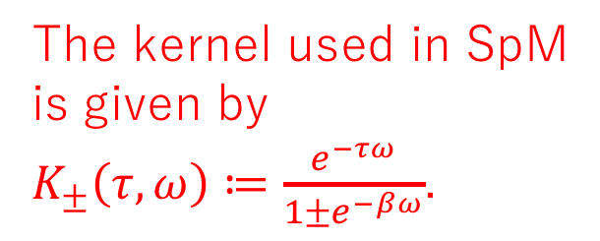
Singular values
SpM
https://spm-lab.github.io/SpM/manual/build/html/index.html
J.Ohtsuki, et al., Phys. Rev. E 95 061302
The kernel used in SpM is given by
$K_{±}\left(τ,ω\right)≔\frac{e^{−τω}}{1±e^{−βω}}$.
0 (double precision)
Singular values of Kernel K decrease exponentially

Slide 12

Brief Usage of SpM
1. Prepare the data of $G(τ)$ “Gtau.in”for a certain temperature $β$.
2. Prepare the table of following parameters “param.in”:
3. Put the command “./SpM.out -i param.in”

Slide 13
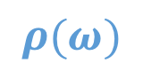
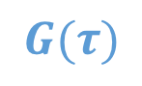
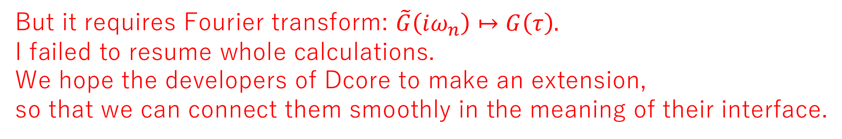
Unified Theme: The Use of a Numerical Analytical Continuation Tool “SpM”
Each member tried to use SpM by their own ways: Sugimoto tried to use output data from DMFT calculation by DCore as input to inference by SpM.
DCore
SpM
parameter
$$G(τ)$$
$$ρ(ω)$$
But it requires Fourier transform: $\tilde{G}\left(iω_{n}\right)↦G\left(τ\right).$
I failed to resume whole calculations.
We hope the developers of Dcore to make an extension,
so that we can connect them smoothly in the meaning of their interface.

